Slide 1
Balancing Equations by Counting Atoms
Counting Atoms is Another Way to Balance by Using Mass

Slide 2
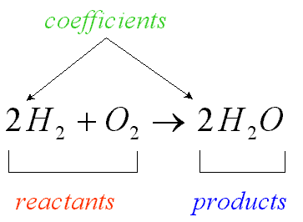
Balancing Equations
Definition: a coefficient in a chemical equation is a whole number written in front of a reactant or a product
Definition: a chemical equation is a statement that uses chemical formulas to show the identities and relative amounts of the substances involved in a chemical reaction

Slide 3
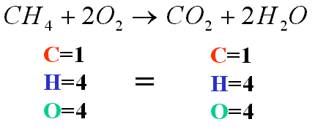
Steps for balancing
1. Write the equation with the correct formulas
2. Count the atoms of the elements in the reactants
3. Count the atoms of the elements in the products
4. Balance the elements one at a time by using coefficients.
5. Begin by balancing the elements that appear only once on each side of the equation. When no coefficient is written, it is assumed to be 1.
7. NEVER balance an equations by changing formula subscripts; Each substance has only one correct formula

Slide 4
ALL CHEMICAL EQUATIONS OBEY THE LAW
THE EQUATIONS ALWAYS SHOW CONSERVATION OF MASS
THE MASS OF THE REACTANTS WILL EQUAL THE MASS OF THE PRODUCTS IF YOU COUNTED ATOMS CORRECTLY

